Slide 1
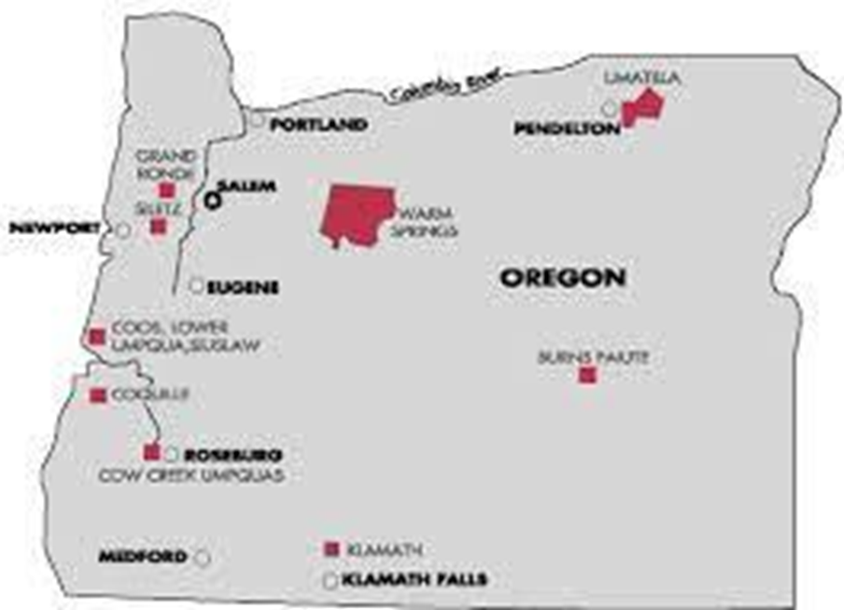
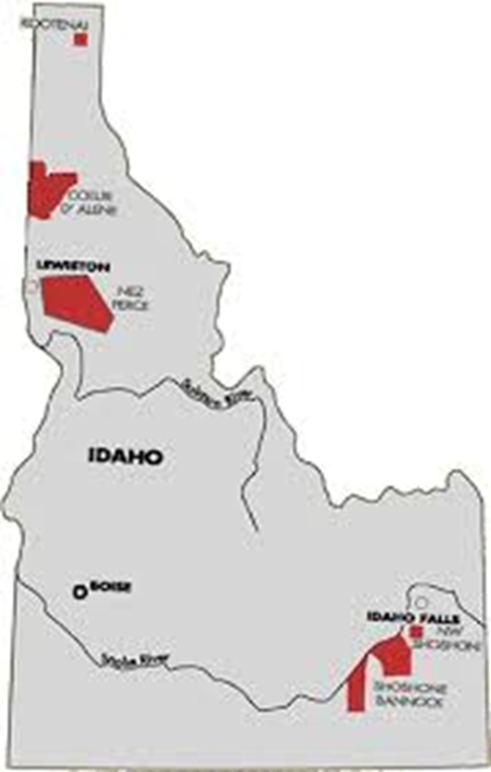
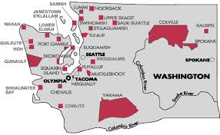
NwONAP Update

Slide 2
NwONAP Staff Updates
Tom Carney
Administrator
Kirsten Franklin- Temple
Administrator Advisor
GRANTS MANAGEMENT
David Boyd – Director
Sandel Ferguson – Team Lead
Shakoe English
Maya Urban
Clint Zarnosky
Joe Anderson
Mandy Ewing
Mayen Akpan
Linda Brenner
GRANTS EVALUATION
Greg Roe – Director
Katie Wilson – Team Lead
Melanie Fisher
Aaron Gerrard
Linda O’Rourke
Marty McCormick
Niki Paganucci
Leslie Jackson
More changes coming!

Slide 3
Grants Management Update
GEMS has arrived!
Submissions of IHP's (or Amendments) and SF-425
Everything you wanted to know about GEMS Webpage
Questions or Concerns, please reach out to your GMS/GES
SF-425 Reporting Submission Requirements
ONAP grant recipients are expected to submit a single completed SF-425 for each open grant 90 days after the end of their program year.
•FY End 12/31/2022 due 3/31/23
•Except for:
•IHBG investment-approved (investing or not!) recipients "must" continue to submit an SF-425 each quarter
•30 days after quarters 1-3
•90 days after fiscal year end (4th quarter)
•ROSS grantees "must" continue to submit an SF-425 each quarter.

Slide 4
Pandemic Funding
NwONAP Cumulative Spending
Funding Source | % disbursed
IHBG ARP | 42%
ICDBG ARP | 44%
IHBG CARES | 78%
ICDBG CARES | 90%
Please prioritize expending ARP and CARES funding distributed in response to the COVID pandemic.
While we do not have any solid dates for the recapturing of funds, we anticipate that this will happen at some point.
If needed, we can assist with "Revisions or Amendments".
* As of 12/20/2023

Slide 5
Grants Management Cont.
Funding Updates
• ICDBG FY 23 – Selection process nearing completion
• IHBG Competitive – NOFO coming!
• FY24 ONAP Program Funding – will be published as soon as the federal budget for FY0224 is passed by Congress
• IHBG Interim Funding and/or ICDBG Imminent Threat Funding - Please reach out to your GMS/GES
• IHBG Formula Census Challenge Deadline – July 29, 2024
Notes:
Mention OMB notice re: extensions?

Slide 6
Other HUD Funding Opportunities
Section 184 Skilled Worker Demonstration Program
Rental Housing for skilled workers
Upfront fee $1, and
no annual guaranteed fee

Slide 7
Grants Evaluation Update
FY24 Monitoring
Standard (IHBG, ICDBG, etc.) funding
6 planned
Hybrid approach (includes on-site)
CARES & ARP funding only
4 planned
Remote approach

Slide 8
Upcoming Training Opportunities
January 16-18: NAHASDA Essentials (virtual)
January 16-18: Development Planning: Operations & Project Management (virtual)
January 24-16: NAHASDA Intermediate (virtual)
February 6-8: ARP Act – Strategic Planning (virtual)

Slide 9
Technical Assistance
Individual Technical Assistance is available.
Please contact your Grants Management Specialist or
Kirsten at kirsten.u.franklin-temple@hud.gov
for additional details.
Technical assistance can be provided in-person or virtually.
Reach out!

Slide 10
Questions

Slide 11
Contact NwONAP
Tom Carney, Administrator
tom.carney@hud.gov
David Boyd, Grants Management Director
david.p.boyd@hud.gov
Greg Roe, Grants Evaluation Director
gregory.a.roe@hud.gov

